Slide 1



CSE & Learning Disabilities Workshop
Unprotected, overprotected: Meeting the needs of children with Learning Disabilities who Experience, or are at Risk of Child Sexual Exploitation
Notes:
Welcome and house keeping
When Jenny speaks this slide can go back up

Slide 2
Aims of the CSE and Learning Disabilities workshop:
To raise awareness about the additional vulnerability of young people with learning disabilities to CSE
To improve our response to children with learning disabilities who experience, or are at risk, of child sexual exploitation
To share local good practice examples of working with young people with learning disabilities

Slide 3
Workshop Format
Setting the scene: Definitions of key concepts Introduction to CSE & LD (includes Bradford CSE Hub)
Table top activity: Why are children and young people with learning disabilities more vulnerable to CSE?
Table top activity: Case studies
10 minute comfort break
Showcasing good practice
Table top activity: Helping Hands
Feedback forms
Stalls and networking

Slide 4
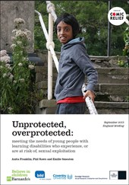
Setting the Scene
Notes:
Samina

Slide 5
Setting the Scene
Definition of learning disabilities
Learning disability meets three criteria:
a significantly reduced ability to understand new or complex information, to learn new skills (impaired intelligence), with;
a reduced ability to cope independently ( impaired social functioning);
which started before adulthood, WITH A LASTING EFFECT ON DEVELOPMENT.
(Development of Health, 2001)
‘A learning disability is a reduced intellectual disability and difficulty with everyday activities – for example household tasks, socialising or managing money – which affects someone for their whole life)’
(www.mencap.org.uk/definition).

Slide 6
Setting the Scene
DEFINITION OF CSE
“Child sexual exploitation is a form of child sexual abuse. It occurs where an individual or group takes advantage of an imbalance of power to coerce, manipulate or deceive a child or young person under the age of 18 into sexual activity (a) in exchange for something the victim needs or wants, and/or (b) for the financial advantage or increased status of the perpetrator or facilitator.
“The victim may have been sexually exploited even if the sexual activity appears consensual. Child sexual exploitation does not always involve physical contact; it can also occur through the use of technology.”
(The Department for Education February 2017)
Notes:
Begin with CSE explanation

Slide 7
Models of Child Sexual Exploitation
Street Grooming/peer on peer
‘Boyfriend’ model
‘Party’ model
Internet grooming
Organised/networked sexual exploitation or trafficking

Slide 8
Vulnerability Factors
Violence/domestic abuse
Looked after Children
Migrant/refuges/asylum seekers
Homelessness
Substance misuse
Learning disabilities
Financially unsupported
Family conflict
Lack of love/security
Adult Sex working
Abuse/neglect in family
Mental health
Breaks in adult relationships
Death of a significant person

Slide 9
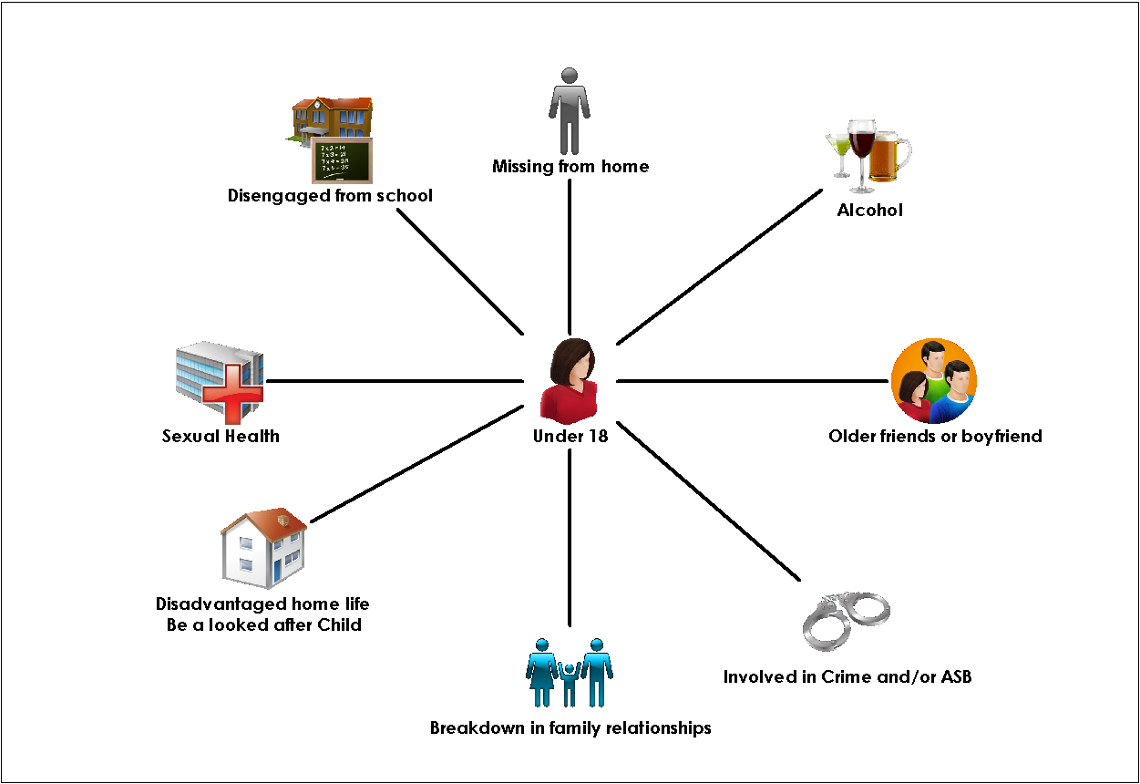
Significant risk indicators

Slide 10
“PUSH” FACTORS
  Missing episodes
  Disengaged from education
  Drug/alcohol use
  Lack of friends/peer relationships
  Living with Domestic Violence
  Homeless/sofa surfing
  Older sibling involved in CSE
  Difficult family relationships
  Looked After Children
  Offending behaviour
  Bullying
  Mental Health issues
  History of abuse
  Peer violence
  Associating with older adults
Notes:
Abusive adults will look out for signs of “push factors” in selecting a child to target.

Slide 11
“PULL” FACTORS
    Receiving affection
    Being taken to adult venues
    Receiving gifts
    Risky situations (encouraged by the abuser)
  Riding around in cars (adventures)
  Being part of gang (belonging)
  Being offered somewhere to stay, where there are no rules.
Notes:
The grooming techniques used to gain the child’s attention, admiration and affection often taps into insecurities or a desire for acceptance and status. We call these “pull factors”.
Pull factors” are opportunities that (appear to) offer excitement, independence or a sense of belonging. These often tempt or trick young people into situations where they are at most risk of being exploited.

Slide 12
Stages of Grooming Process
Targeting stage
Friendship forming stage
Loving relationship stage
Abusive relationship stage
Notes:
First included in the Sexual Offences Act 2003
“A process by which a person prepares a child, significant adults and the environment for the abuse of this child. Specific goals include gaining access to the child, gaining the child’s compliance and maintaining the child’s secrecy to avoid disclosure” Craven, Brown & Gilchrist (2006) Observing the child/young person
Selection of child/young person, Befriending—being nice, giving gifts, caring, taking an interest, giving compliments, etc, Gaining and developing trust, Sharing information about young people between other abusive adults,
Making young people feel special, Giving gifts and rewards, Spending time together, Listening and remembering, Keeping secrets, Being there for them, ‘No one understands you like I do’; being their best friend, testing out physical contact—accidental touching, Offering protection
Being their boyfriend/girlfriend, Establishing a sexual relationship, Lowering their inhibitions - e.g., showing them pornography , Engaging them in forbidden activities - e.g. going to clubs, drinking, taking drugs, Being inconsistent - building up hope and then punishing them
Unloving’ sexual relationship, Withdrawal of love & friendship, Dependency, Isolation from family & friends, Manipulation - ’you owe me’, Threatening behaviour, Physical violence, Sexual assaults, Forced sex with others, Giving drugs, Playing on the young person’s feeling of guilt, shame and fear,

Slide 13
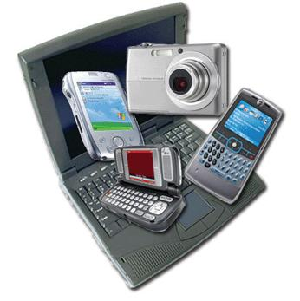
Child exploitation and digital technologies
Notes:
Social media, facebook, twitter, snapchat, uvoo, instagram, bebo, myspace, dating sites , grinder, tinder,
SEXTING
When a young person takes an indecent image of them self and sends this to their friends or boy/girlfriends via mobile phones.
By having in their possession, or distributing, indecent images of a person under 18 on to someone else – young people are not even aware that they could be breaking the law as these are offences under the Sexual Offences Act 2003.

Slide 14
Bradford Child Sexual Exploitation Hub
Partnership approach
( partners who contribute towards the CSE Hub)
Childrens Social Care
Police
Barnardo’s Turnaround
Health
Placement Support Service
Childrens Society Hand In Hand
Blast
Education

Slide 15
Bradford Child Sexual Exploitation Hub
Roles and responsibilities of the Hub
Partner agencies meet every morning to discuss information/intelligence/referrals from the previous 24 hours
Identifying children at risk
New referrals
Sharing Intelligence
Review actions from the previous day
Developing agreed action plans
The focus of the meeting is the safety and protection of children
Training and awareness raising

Slide 16
Bradford Child Sexual Exploitation Hub
Roles and responsibilities of the Hub
CSC – assessments, supporting staff working with YP at risk of CSE, CSE planning meetings
Police – Investigation and Disruption
Turnaround ( Blast, Hand In Hand & PSS) Direct work with YP to increase their knowledge and understanding of CSE and risk in order to keep themselves safe
Health- HNA, direct work with YP around all health issues, supporting health staff and other agencies around health issues

Slide 17
Bradford Child Sexual Exploitation Hub
Roles and responsibilities of the Hub
Joint investigations by Police & CSC
Multi agency response to all YP at risk of CSE and to ensure there is a clear plan in place for each child
Empower and support children and YP through the criminal justice system
Supporting research into CSE
Relationship building with YP to encourage them to engage with services
Helping YP realise they are victims of abuse
Police disruption – perpetrators/areas/venues
Barnardos Night Time economy project

Slide 18
Bradford Child Sexual Exploitation Hub
Referral Process
If a child is at immediate risk of harm referrer needs to contact Children's Social Care’s Initial Contact Point for action to be taken to safeguard the child.
If there are concerns that a child may be at risk of sexual exploitation then a CSE Risk Assessment referral should be sent to Children's Social Care Initial Contact Point -
cyp-cicp@bradford.gov.uk or phone 01274 437500. The referral will then be sent direct to the CSE Hub.
If you are unsure you can contact the CSE Hub on 01274 435049
Referrer will be contacted and informed of the outcomes and actions recommended from the CSE Hub.

Slide 19
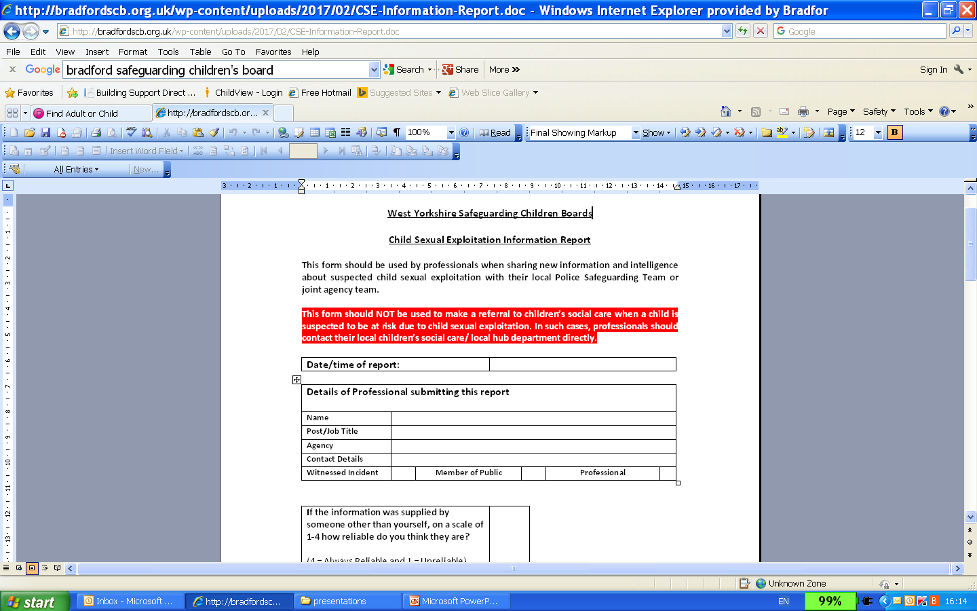
Bradford Child Sexual Exploitation Hub
CSE Information Report

Slide 20
Bradford Child Sexual Exploitation Hub

Slide 21
Bradford Child Sexual Exploitation Hub
Overall Assessed Level of CSE Risk
No risk | Whilst there may be concerns for the welfare of the child /young person, which may involve the requirement of service provision, for other assessed risks, the assessment or risk indicates that there is no current risk of the child /young person being at risk of, or experiencing sexual exploitation.
Low Risk | The indicators and assessment raise some concerns that the child /young person is at risk of sexual exploitation, and /or places him /or herself at risk. Concern that the child / young person is at risk of being targeted or groomed, but there are positive protective factors in the child /young person life.
Medium Risk | The assessment indicates that the child /young person is vulnerable to being sexually exploited / but that there are no immediate /urgent safeguarding concerns. There is evidence the child /young person may be a risk of opportunistic abuse, or is being targeted /groomed. The child /young person may experience protective factors, but circumstances and /or behaviours place him / her at risk of sexual exploitation.
Highest Risk | Indicators /Assessment /Evidence /disclosure, suggests that the child /young person is assessed to be engaged in high risk situations / relationships /risk taking behaviour and is at immediate risk of, or is experiencing sexual exploitation. (They may not recognise this)
Notes:
Overall Assessed Level of CSE Risk
No risk
Whilst there may be concerns for the welfare of the child /young person, which may involve the requirement of service provision, for other assessed risks, the assessment or risk indicates that there is no current risk of the child /young person being at risk of, or experiencing sexual exploitation.
Low Risk
The indicators and assessment raise some concerns that the child /young person is at risk of sexual exploitation, and /or places him /or herself at risk.
Concern that the child / young person is at risk of being targeted or groomed, but there are positive protective factors in the child /young person life.
Medium Risk
The assessment indicates that the child /young person is vulnerable to being sexually exploited / but that there are no immediate /urgent safeguarding concerns. There is evidence the child /young person may be a risk of opportunistic abuse, or is being targeted /groomed.
The child /young person may experience protective factors, but circumstances and /or behaviours place him / her at risk of sexual exploitation.
Highest Risk
Indicators /Assessment /Evidence /disclosure, suggests that the child /young person is assessed to be engaged in high risk situations / relationships /risk taking behaviour and is at immediate risk of, or is experiencing sexual exploitation. (They may not recognise this)
Low risk – every 3 months
Medium risk – every 3 months
High risk – bi-monthly

Slide 22
Bradford Child Sexual Exploitation Hub
Telephone Contact numbers
Childrens Contact point – 01274 437500
CSE Hub – 01274 435049
Emergency Duty Team – 01274 431010
Turnaround (BFD) – 01274 434222
Hand in Hand (Keighley) 01535 606868
Blast – 0113 2444209 (www.mesmac.co.uk/blast)
PACE – 0113 240 3040 (www.paceuk.info/support-for-parents/)

Slide 23
Bradford Child Sexual Exploitation Hub
?
Any questions

Slide 24
Table Top Activity
Q. Why are children and young people with
learning disabilities more vulnerable to CSE?

Slide 25
“Young people with learning disabilities are a perpetrators dream… they’re often lonely and isolated. Many of them have not had a boyfriend or girlfriend but would like one. Many spend a lot of time online. They are less likely to understand that sexual exploitation is wrong and are so easy to groom.”
CSE specialist practitioner.

Slide 26
Q. Why are children and young people with learning disabilities more vulnerable to CSE?
Over-protection and infantilisation= unprotected
Social isolation
Lack of empowerment and voice
A lack of access to information and education on sex and relationships
False perception around sexuality and disability
Lack of knowledge and awareness of the sexual exploitation of children with learning disabilities amongst professionals and general public.
General absence of CSE and learning disability training for professionals.
Invisibility of children with learning disabilities within services

Slide 27
Case Studies

Slide 28

Comfort Break

Slide 29
Showcasing Good Practice
Specialist School Nurses Team
RSE Co-ordinator High Park School
Sexual Health Team
Bradford & Keighley Youth Services
Specialist Inclusion Service
Turnaround

Slide 30
Preventing Child Sexual Exploitation – Sharing Good Practice
RSE Additional Needs Training
Tina Wildy – Nurse Specialist Special Needs
Wendy Yates – RSE Co-ordinator High Park School
Nicola Hawkins - Sexual Health Team

Slide 31
The Journey So Far
Setting up the steering group – Education and Health collaboration 2010
Sharing information with Barnados
Develop the training package – UR Choice Plus: Change videos, Life model photos, Boardmaker access in Libraries, finding resources etc.
Delivering Training days to school, respite and parents.
Programme developed and evolved to current day – RSE Additional Needs Training and Resources

Slide 32
Key areas of learning for pupils with Additional Needs
Our bodies – This is me: self-awareness and gender
Relationships – circles of Touch
Friendships – circles of Touch, sharing, permission and consent personal/interpersonal boundaries (greetings, touch circles)
Public and private (places, actions, language and body parts)
Staying safe – assertiveness, self-advocacy, control over own body
Feeling good and taking care of ourselves – self-care, health and hygiene, emotional wellbeing
Puberty (growth, body changes, wet dreams, erections, menstruation)
Appropriate touch/behaviour for Public and Private spaces and places
Notes:
Ask audience before showing this slide

Slide 33
What are the barriers?
The young person’s physical development does not match their level of understanding or their personal view of their development.
Getting support from parents and carers
Difficulties with understanding consent, social norms and relationships
Accessible resources that help to explain these abstract concepts.
Notes:
Ask audience before showing slide

Slide 34


Public and Private

Slide 35
The Training Aims to:-
provide an overview of the essential areas that students need to know and be taught to keep safe.
use the Resource CD from the RSE Additional Needs Program and other appropriate sources
Experience some of the resources and activities and assess their suitability for use with your students.
Developing staff understanding and skills in managing inappropriate sexualised touch behaviours – reasons and strategies within a safeguarding framework.

Slide 36
Bradford Youth service
Working with young people with Learning difficulties on CSE issues

Slide 37
Where we work with learning disabled young people includes…..
Youth Clubs
Youth Cafes
Detached and Outreach
One to One work
Vulnerable/ child in need / Buddies caseloads
Schools work
Partnership projects
Communities of interest/specialist groups

Slide 38
Some of the ways we engage learning disabled young people on issue based work include….
Arts/Drama
Music
Sports/ outdoors
Group work
Games/ puppets
Workshops
Social Media
Events
One to one conversation

Slide 39
Our specific projects for learning disabled young people
We have projects in each constituency and so far have covered issues such as…
Personal space
Touch and appropriateness
Healthy relationships
Internet safety
Friendships & safe people
Sexuality

Slide 40
Playing with Recourses
The recourses we have used so far have been collated from
Barnardo’s / Turnaround
NHS Trust
Going Further- Sex and relationships Education Course
Bradford Council
CEOP
Child net international
Many Thanks

Slide 41

Helping Hand
Q. What would help practitioners to support and respond to children with learning disabilities who experience, or are at risk, of child sexual exploitation

Slide 42
Final thoughts …
Summary
Feedback forms
Networking

